Slide 1
YOUR
LOGO
YOUR COMPANY NAME
COMPETITIVE ANALYSIS

Slide 2
OBJECTIVES
[Describe why an analysis is important and what you hope to find through it.]
Point
Point
Point
Point
COMPETITIVE ANALYSIS | OVERVIEW

Slide 3
ANALYSIS QUESTIONS
What products do competitors offer?
Are competitors making money?
???
LANDSCAPE ANALYSIS

Slide 4
 |  | YOUR COMPANY | COMPETITOR 1 | COMPETITOR 2 | COMPETITOR 3
PROFILE | OVERVIEW
 | COMPETITIVE ADVANTAGE What value do you offer customers?
MARKETING PROFILE | TARGET MARKET
 | MARKETING STRATEGIES
LANDSCAPE ANALYSIS

Slide 5
 |  | YOUR COMPANY | COMPETITOR 1 | COMPETITOR 2 | COMPETITOR 3
PRODUCT PROFILE | PRODUCTS & SERVICES
 | PRICING & COSTS
 | DISTRIBUTION CHANNELS
SWOT ANALYSIS | STRENGTHS
 | WEAKNESSES
 | OPPORTUNITIES
 | THREATS
LANDSCAPE ANALYSIS

Slide 6
Include Screenshot
Describe Sources Used for Analysis
Reports and trends
Social media
Consumer awareness
????
LANDSCAPE ANALYSIS

Slide 7
LANDSCAPE INFLUENCES
Use Porter’s Five forces to describe landscape:
Competitor rivalry
Threat of new entrants
Bargaining power of buyers
Bargaining power of suppliers
Threat of substitute products or services
THREAT
OF ENTRY
BARGAINING POWER
OF BUYERS
COMPETITOR RIVALRY
THREAT
OF SUBSTITUTES
BARGAINING POWER
OF SUPPLIERS
LANDSCAPE ANALYSIS

Slide 8
THREAT OF ENTRY | THREAT OF SUBSTITUTES | BARGAINING POWER OF BUYERS | BARGAINING POWER OF SUPPLIERS | COMPETITOR RIVALRY
LANDSCAPE ANALYSIS

Slide 9
COMPETITOR SEGMENTATION
Using the competitors identified in analysis, we will segment the competitive landscape in terms of [number] attributes:
Attribute one
Attribute two
Attribute three
We chose these determinant attributes for several reasons:
Attribute example
[If not this example, then Reason 1]
[Reason 2]
COMPETITOR SEGMENTATION

Slide 10
COMPETITOR SEGMENTATION GRAPH
[Use Smartsheet Segmentation Graph Template to construct graph for presentation.]
COMPETITOR SEGMENTATION

Slide 11
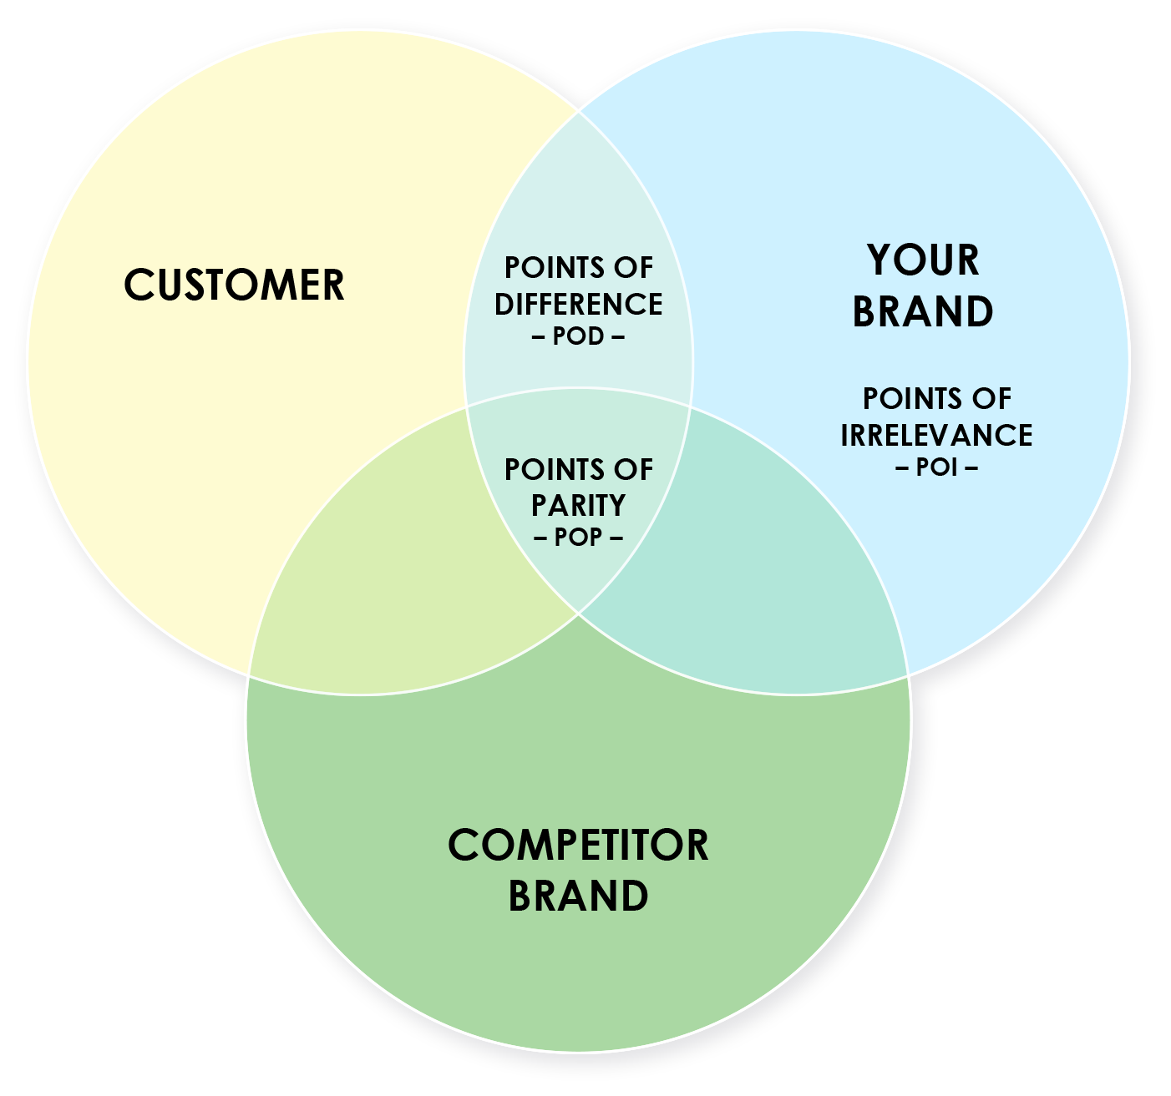
POINTS OF DIFFERENCE – POD – | POINTS OF PARITY – POP – | POINTS OF IRRELEVANCE – POI –
POINTS OF PARITY

Slide 12
RECOMMENDATION NAME ONE
Detail one
Detail two
Detail three
RECOMMENDATION NAME TWO
Detail one
Detail two
Detail three
RECOMMENDATION NAME THREE
Detail one
Detail two
Detail three
RECOMMENDATIONS

